Slide 1
"Unit 9: "For Live Session"
Chad Madding

Slide 2
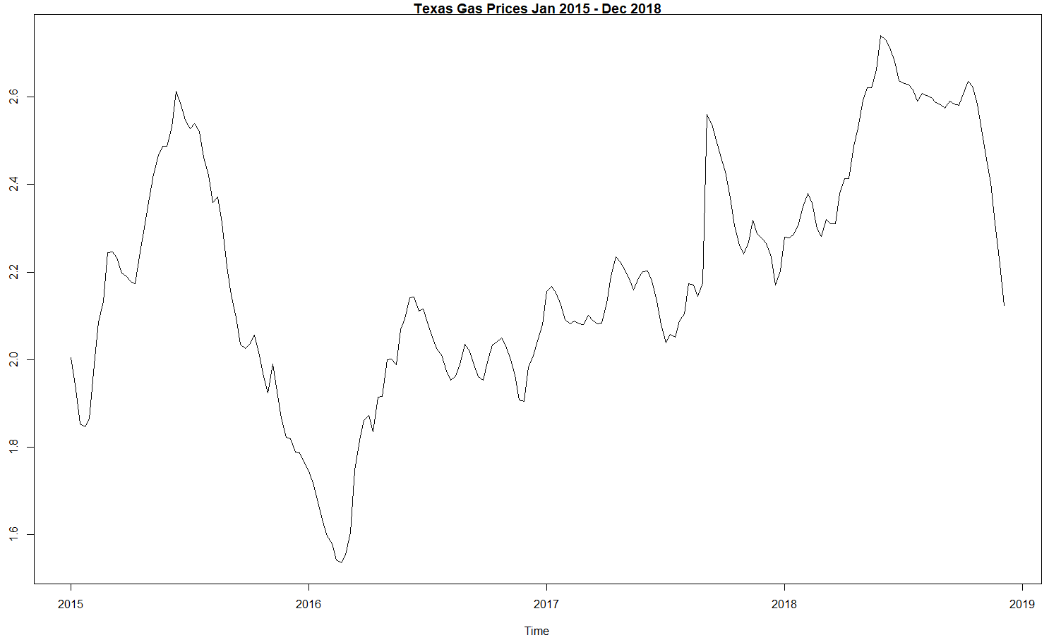
1. Fit an AR(2) to the data using the maximum likelihood estimates (mle).
texasgasprice.mle=est.ar.wge(texasgasprice,p=2,type='mle')
$`phi`
[1] 1.3811579 -0.4077432
$avar
[1] 0.002110579
$aic
[1] -6.131525
$aicc
[1] -5.120793
$bic
[1] -6.082895

Slide 3
2. Fit an AR(2) to the data using the Burg (burg) estimates.
texasgasprice.burg=est.ar.wge(texasgasprice,p=2,type='burg')
$`phi`
[1] 1.3813631 -0.4058498
$avar
[1] 0.002110439
$aic
[1] -6.131591
$aicc
[1] -5.120859
$bic
[1] -6.082962

Slide 4
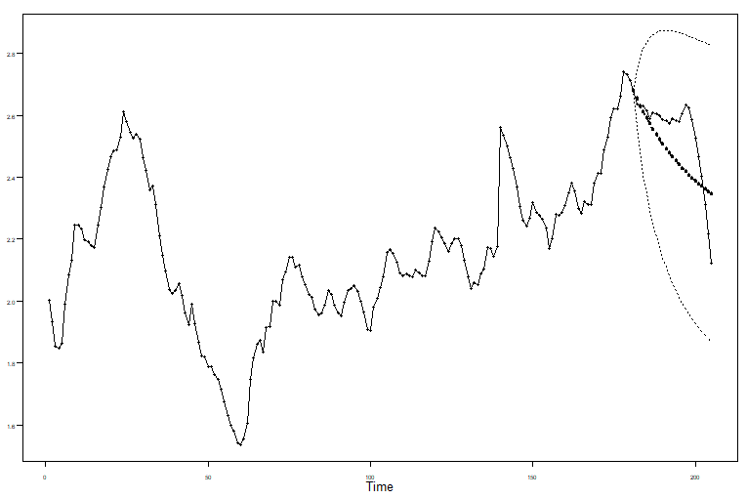
3. Find the ASE for the maximum likelihood fit by forecasting the last 24 weeks of the series.
texasgasprice.mle.est = fore.arma.wge(texasgasprice, phi = texasgasprice.mle$phi, theta = 0,lastn = T, n.ahead = 24)
texasgasprice.mle.ase = mean((texasgasprice[(205-24+1):205] - texasgasprice.mle.est$f)^2)
$`f`
[1] 2.654976 2.632081 2.611070 2.591385 2.572765 2.555075 2.538233 2.522185 2.506888 2.492303 2.478396 2.465136 2.452492 2.440435
[15] 2.428938 2.417976 2.407522 2.397554 2.388049 2.378985 2.370342 2.362101 2.354243 2.346749
$wnv
[1] 0.002107055
$se
[1] 0.04590267 0.07827176 0.10424212 0.12514152 0.14221251 0.15639458 0.16835911 0.17858343 0.18741203 0.19509920 0.20183730
[12] 0.20777540 0.21303146 0.21770065 0.22186096 0.22557723 0.22890395 0.23188741 0.23456723 0.23697760 0.23914818 0.24110485
[23] 0.24287031 0.24446451
$psi
[1] 1.3811579 1.4998541 1.5083777 1.4717526 1.4176920 1.3579596 1.2975024 1.2383570 1.1813189 1.1266563 1.0744156 1.0245513
[13] 0.9769815 0.9316120 0.8883457 0.8470873 0.8077445 0.7702287 0.7344551 0.7003431 0.6678153 0.6367983 0.6072219 0.5790192
texasgasprice.mle.ase
#[1] 0.01461187

Slide 5
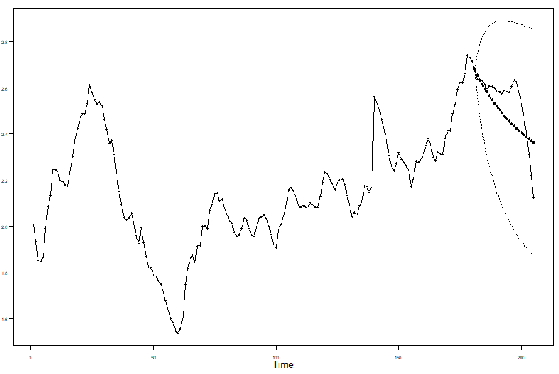
4. Find the ASE for the Burg fit by forecasting the last 24 weeks of the series.
texasgasprice.burg.est = fore.arma.wge(texasgasprice, phi = texasgasprice.burg$phi, theta = 0,lastn = T, n.ahead = 24)
texasgasprice.burg.ase = mean((texasgasprice[(205-24+1):205] - texasgasprice.burg.est$f)^2)
$`f`
[1] 2.656061 2.634598 2.615072 2.596810 2.579508 2.563019 2.547264 2.532193 2.517768 2.503959 2.490738 2.478079 2.465958 2.454353
[15] 2.443241 2.432601 2.422414 2.412659 2.403319 2.394376 2.385813 2.377614 2.369763 2.362247
$wnv
[1] 0.002107158
$se
[1] 0.04590379 0.07828129 0.10432501 0.12537007 0.14264960 0.15708945 0.16934817 0.17989236 0.18905795 0.19709255 0.20418333
[12] 0.21047527 0.21608317 0.22109971 0.22560094 0.22965021 0.23330085 0.23659828 0.23958151 0.24228427 0.24473594 0.24696226
[23] 0.24898587 0.25082677
$psi
[1] 1.3813631 1.5023143 1.5146157 1.4825204 1.4331925 1.3780787 1.3219663 1.2668226 1.2134222 1.1620371 1.1127280 1.0654690
[13] 1.0201992 0.9768452 0.9353303 0.8955784 0.8575154 0.8210698 0.7861732 0.7527596 0.7207662 0.6901325 0.6608008 0.6327157
texasgasprice.burg.ase
#[1] 0.01309828

Slide 6
5. Which model would you choose?
Looking at the ASE for both the maximum likelihood estimates and the Burg estimates, the Burg would be the one to choose based solely on the ASE.
texasgasprice.mle.ase
#[1] 0.01461187
texasgasprice.burg.ase
#[1] 0.01309828

Slide 7
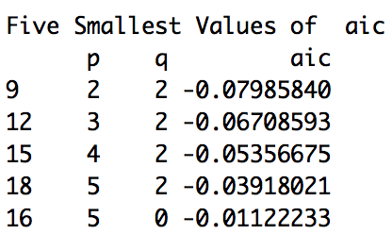
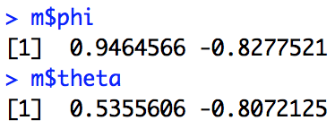
A brief reflection of thoughts and key takeaways – Week 9 p1
Consider the data in PutItTogether1.csv.
Visualize/plot the data.
plotts.wge(PutItTogether) #data read into array PutItTogether
Use aic.wge() or aic5.wge() to identify estimates of p and q.
aic5.wge(PutItTogether)
Use the estimate of p and q to get estimates of the phis and thetas.
m = est.arma.wge(PutItTogether, p = 2, q = 2)
Use the estimated model to forecast and so on.
fore.arma.wge(PutItTogether, phi = m$phi, theta = m$theta, n.ahead = 20)
Note: We are assuming a stationary process and have not investigated the spectral density, acfs, and so on to make sure that key properties of the data are preserved. We will address all of these topics together in the model-building unit to come!

Slide 8
A brief reflection of thoughts and key takeaways – Week 9 p2
The basic parameter estimation method is maximum likelihood.
Burg estimates have desirable properties for AR models.
We don’t recommend using Yule-Walker estimates.
We recommend AIC-type model identification over the Box-Jenkins pattern recognition approaches.
Notes:
In this unit, we have discussed parameter estimation and model identification based on stationary models.
In the next unit, we will discuss fitting non-stationary ARIMA, seasonal, and signal-plus-noise models.

